Slide 1

New Employee Benefits Orientation
2021 Benefits
Houston County Board of Education

Slide 2
Benefits Portfolio
BOARD PAYS ALL
OR PART
State Health
Long Term Disability
Basic Life
Dental
Sick Leave
Retirement
Employee Assistance Program
YOUR
CONTRIBUTION
State Health
Retirement (TRS or PSERS)
Flexible Spending Accounts
Optional / Dependent Life
Short Term Disability
Dental
Supplemental Retirement (403(b) / 457 / Roth)

Slide 3

Eligibility and Plan Year Information
Benefits Plan Year = Calendar Year (January – December)
New Employee benefits
  Begin the 1st of the month following a full calendar month worked
  Monthly payroll deductions – 1 month in advance of coverage
  No changes until Open Enrollment without Qualifying Life Event
  Open Enrollment is mid Oct – mid Nov for Jan 1 coverage
  Qualifying Events (i.e. marriage, birth, loss/gain of coverage) – changes allowed within 31 days of event

Slide 4
Enrollment Information
State Health Benefit Plan
  Review the 2021 Active Employee Decision Guide
  Dependent documentation is required
    Follow specific ADP instructions to add dependents to the medical plan
    Submit documentation to ADP and the Benefits Office in the format required by the deadline provided by ADP in order for dependents to be covered
  Transfers in from other Georgia systems
    Confirm current SHBP coverage
    No SHBP changes are permitted until next Open Enrollment

Slide 5
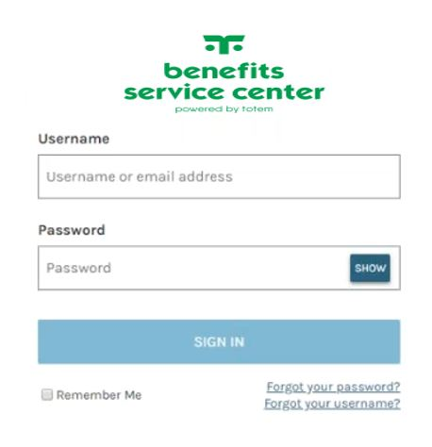

Enrollment Deadline
Local Benefits – Enroll by midnight on New-Hire meeting day – mandatory task for all staff
Health Benefits – Enroll on date of hire – only if enrolling in health plan
Review HCBE & SHBP/ADP Confirmation Statements for accuracy
Keep Confirmation Statements for your documentation

Slide 6
Dependent Eligibility
Before you enroll your dependents…
Health / SHBP
  Dependent children are eligible until age 26
  Coverage continues through the end of the month of the 26th birthday
Local / Dental and Life
  Dependent children are eligible until age 26
Is your spouse also an HCBE employee?
  Avoid duplicate life or dental coverage

Slide 7

State
Health
Benefit Plan
(SHBP)

Slide 8


SHBP Plan Options
HRA
Gold, Silver, and Bronze
No Copays
HMO
Lower deductible
Copays
In-Network coverage only
anthem.com/SHBP
High Deductible Health Plan (HDHP)
Lowest premiums
Highest deductible and out-of-pocket expense
HMO
Lower deductible
Copays
In-Network coverage only
welcometouhc.com/shbp

Slide 9
Benefit Summary
 | ANTHEM GOLD HRA | ANTHEM SILVER HRA | ANTHEM BRONZE HRA | UHC & ANTHEM HMO | UHC HDHP
In-Network Deductible
You | $1,500 | $2,000 | $2,500 | $1,300 | $3,500
You + Child(ren)/Spouse | $2,250 | $3,000 | $3,750 | $1,950 | $7,000
You + Family | $3,000 | $4,000 | $5,000 | $2,600 | $7,000
Medical Out-Of-Pocket Max
You | $4,000 | $5,000 | $6,000 | $4,000 | $6,450
You + Child(ren)/Spouse | $6,000 | $7,500 | $9,000 | $6,500 | $12,900
You + Family | $8,000 | $10,000 | $12,000 | $9,000 | $12,900
Coinsurance (Plan Pays) | 85 % | 80 % | 75 % | 80 % | 70 %
PCP/Specialist Visit | Coins After Ded | Coins After Ded | Coins After Ded | $35/$45 Copay | Coins After Ded
Plan Provided HRA Credits
You | $400 | $200 | $100 | N/A | N/A
You + Spouse or + Child(ren) | $600 | $300 | $150 | N/A | N/A
You + Family | $800 | $400 | $200 | N/A | N/A

Slide 10
Anthem HRA Plans
Three HRA plans – Gold, Silver & Bronze
Varying deductibles, coinsurance and HRA funding
Medical services are subject to a deductible first, then coinsurance
Out-of-Pocket maximum includes deductibles and pharmacy expenses
The HRA (Health Reimbursement Account) is board-funded, provides first dollar coverage;
offsets your medical and pharmacy costs
Unused HRA balances roll-over to future years
The HRA plans do not include copays
Some drug costs are waived for participation in Disease Management (diabetes, asthma, coronary artery disease)

Slide 11

Anthem and UHC HMO Plans
In-network coverage only
Copays for Physician and Specialist visits
Most other services are subject to a deductible and coinsurance
Out-of-pocket Maximum includes deductibles, copays and pharmacy expenses
Some drug costs are waived for participation in Disease Management (diabetes, asthma, coronary artery disease)

Slide 12

UHC HDHP Plans
All services including pharmacy expenses are subject to deductible
No copays
Once you meet your deductible, you pay coinsurance until you meet the out-of-pocket maximum
Lowest premiums
Highest out-of-pocket costs for medical services

Slide 13

SHBP Pharmacy Benefits
CVS Caremark is the pharmacy vendor
Retail, mail order, home delivery, and specialty pharmacy services
Extensive retail network
  Local retail and chain pharmacies included, not limited to CVS

Slide 14

SHBP Pharmacy Benefits
Pharmacy Tier | Anthem Gold, Silver, & Bronze HRA Plans | Anthem & UHC HMO Plans
Tier 1 | 15% ($20 Min/$50 Max) | $20 copay
Tier 2 | 25% ($50 Min/$80 Max) | $50 copay
Tier 3 | 25% ($80 Min/$125 Max) | $90 copay

Slide 15
Medical Monthly Premiums
PLAN OPTIONS | YOU | YOU + CHILD(REN) | YOU + SPOUSE | YOU + FAMILY
ANTHEM HRA GOLD | $175.68 | $320.11 | $436.33 | $580.76
ANTHEM HRA SILVER | $114.32 | $215.80 | $307.47 | $408.95
ANTHEM HRA BRONZE | $76.58 | $151.64 | $228.22 | $303.28
ANTHEM HMO | $143.03 | $264.61 | $367.76 | $489.34
UHC HMO | $174.49 | $318.09 | $433.83 | $577.43
UHC HDHP | $61.83 | $126.57 | $197.24 | $261.98
HCBE contributes $945 per employee per month, or
$11,340 per employee per year towards medical coverage

Slide 16


SHBP Wellness Program
All SHBP Plans Offer Well-Being Incentive Credits
Personalized health recommendations based on health behaviors and interests
Well-Being incentive credits can be redeemed for incentive credits, a Visa gift card, or a Walmart gift card
www.bewellshbp.com

Slide 17
SHBP Wellness Program
All SHBP Plans Offer Well-Being Incentive Credits for Employees and Spouses
Take Action with Coaching or Online Pathway
Phone Coaching: Earn 60 credits for one call each month up to 4 times/year
Online Pathway: Earn 120 credits up to 2 times, for a maximum of 240 credits per year.
Earn 240 in credits
(480 for you and spouse)
Well-Being Assessment (Real Age Test), a confidential, online questionnaire about your health PLUS
Biometric Screening Assess your Health
Earn 240 in credits
(480 for you and spouse)
Employees and spouses may complete tasks between
January 1, 2021 and November 30, 2021

Slide 18
SHBP Wellness Program
UHC High Deductible Health Plan
Before you can use your well-being incentive credits, you must meet this portion of your deductible:
You: $1,350
You + Child(ren): $2,700
You + Spouse: $2,700
Family: $2,700
Note: UHC matches the first 240 employee well-being incentive credits

Slide 19

Telemedicine Benefit
Available to all SHBP members: 24/7 access to physicians through your smartphone, tablet, or computer with a webcam by visiting https://livehealthonline.com/
See and talk to a participating doctor while at home, work or on the go; can receive a consult, diagnosis, and prescriptions, as necessary
In-network coverage only
Copay for HMO
Coinsurance for HRA
Deductible for HDHP

Slide 20

Tricare Supplement Plan
Coverage Level | TriCare Supplement Premiums
You | $60.50
You + Child(ren) or Spouse | $119.50
You + Family | $160.50
For retired military
A supplement to your current TriCare benefits
Contact www.asicorporation.com/ga_shbp for benefits information

Slide 21


PeachCare for Kids
Your children may be eligible for PeachCare
Low cost health insurance
Access www.peachcare.org
  Eligibility information
  Benefits and cost information

Slide 22
Local
HCBE
Benefits

Slide 23

Gym Membership: Max Fitness
  To further encourage your well-being, HCBE pays for all benefit employees to receive a VIP gym membership to Max Fitness, located at 112 Sutherlin Drive, Warner Robins, GA 31088.
  The board provided membership includes use of the gym floor, cardio equipment, locker rooms, and saunas.
  To start your free gym membership, stop by Max Fitness to sign up with your HCBE employee badge or call 478-313-5225.
  Employee Upgrade Options with Additional Services :
    VIP Plus Plan or Family Plan

Slide 24

Dental Plan Benefit Options
MetLife Dental Plan
High and Low Dental Plan options
In and out-of-network benefits
Remain in-network to reduce out-of-pocket costs
To find a Participating Provider:
Visit www.metlife.com/dental
In the “Find a Dentist” box, select PDP Plus as the network

Slide 25
Dental Plan Benefit Summary
BENEFIT HIGHLIGHTS (refer to Certificate for additional details)
Type of Service | Low Plan In-Network | High Plan In-Network
Type A - Cleanings, exams, fluoride to age 19, x-rays, & more | 100% | 100%
Type B – Fillings, simple extractions, perio. maintenance, space maintainers, sealants for children, and more | 60% | 80%
Type C – Surgical extractions, bridges, crowns, dentures | 50% | 50%
Type D – Orthodontia | 50% | 50%
PLAN DEDUCTIBLE & MAXIMUMS
 | Low Plan (In-network) | High Plan (In-network)
Deductible | Ind $75 / Fam $225 | Ind $50 / Fam $150
Annual Maximum | $750 per person | $1500 per person
Ortho Maximum | $750 per person | $1500 per person

Slide 26
Dental Plan Premiums
Dental Coverage | Monthly Payroll Deduction Low Plan | Monthly Payroll Deduction High Plan
Employee Only | $19.19 | $30.54
Employee + Spouse | $43.92 | $67.60
Employee + Child(ren) | $50.10 | $76.59
Family | $82.93 | $121.40
HCBE contributes an additional $5 per month toward premium

Slide 27

Flexible Spending Accounts (FSA)
Medcom is the FSA administrator
Pre-tax contributions
Two accounts to choose from:
Dependent Care FSA (day care, ASP fees)
Healthcare FSA (medical / dental / vision costs)
Monthly contributions help you budget for larger expenses
You don’t have to be enrolled in our plans to participate
Claim expenses for all dependents claimed on taxes

Slide 28
Healthcare FSA
Healthcare FSA Expenses
Medical and dental plan deductibles, coinsurance, pharmacy
Vision expenses: SHBP includes an exam benefit.
Use your FSA account to purchase contacts / glasses
Check the eligible expense list online
You are not eligible for this plan if currently enrolled in a Health Savings Account (HSA).
Annual Healthcare FSA max is $2,750
Up to $550 of unused Healthcare FSA funds carry over to next year as long as you have a $25 balance

Slide 29
Dependent Care FSA
Dependent Care FSA Expenses
Child day care and after school care for children up to age 13
Certain adult day care expense
About your Dependent Care Account
Dependent Care funds are available once applied to your account
Wait until the money is in your account for reimbursement
Annual Household Dependent Care FSA max is $5,000

Slide 30



FSA Debit Cards
Documentation may be requested for debit card transactions
Sample Debit Card

Slide 31
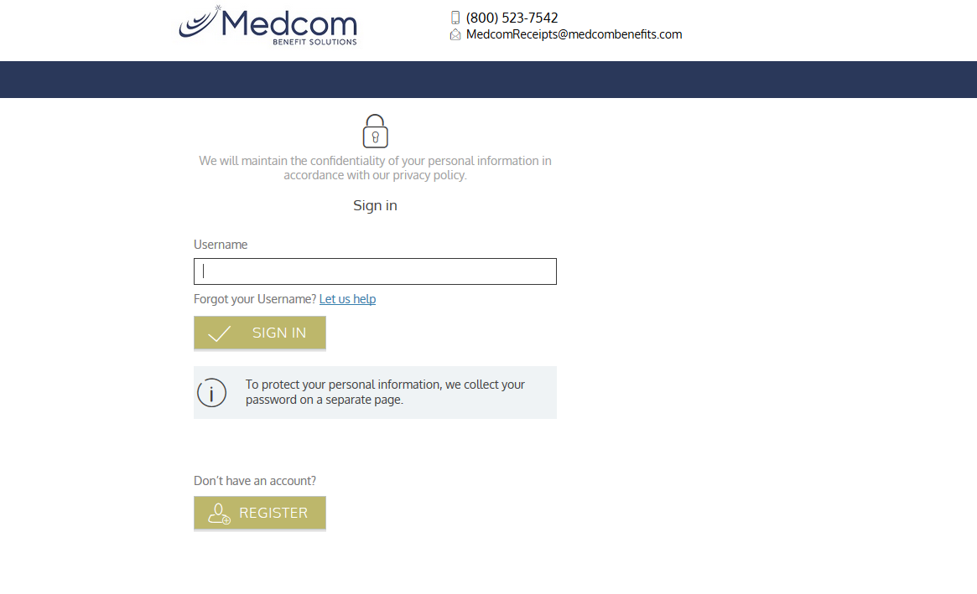
Medcom – Online Portal
www.medcombenefits.com
Create an Online Account
Check your FSA Balance
View Eligible Expense Information
File Claims and Submit Documentation
Request Replacement Debit Card

Slide 32

Medcom – Mobile App
Manage your account on the go with
the WealthCare Mobile App by Medcom
Access your benefits – 24 hours a day, 7 days a week
Submit claims for reimbursement
Access account balances, transaction history, and claims status
Take a picture of your receipt and submit for a claim
View important messages
Sign up for text alerts

Slide 33

Basic Life & Beneficiary Information
The Hartford Life Insurance Plan
HCBE provides Basic Life Insurance in the amount of 1 times salary up to $50,000 at no cost to you
Elect optional life at 1, 2, 3, 4, or 5 times salary
As a new-hire, you may elect up to 3 times your salary with no medical questions
Dependent Life coverage is available for your family too:
  Spouse - $ 5,000, $10,000, or $25,000
  Spouse - $50,000 (must complete EOI)
  Child - $5,000 or $10,000
Elect dependent life now with no medical questions
Is your spouse an HCBE employee? If so, duplicate coverage is not permitted.
Designate a Primary and Secondary beneficiary

Slide 34
Optional Life Insurance
Employee & Spouse Rates per $1,000
Age 0-29 | $0.045
Age 30-34 | $0.055
Age 35-39 | $0.07
Age 40-44 | $0.11
Age 45-49 | $0.16
Age 50-54 | $0.25
Age 55-59 | $0.42
Age 60-64 | $0.672
Age 65-69 | $0.936
Age 70-74 | $1.896
Age 75+ | $2.07
Employee Optional Life
1 to 5 times earnings
to a maximum of $500,000
Spouse Life
$5,000 = $1.53 or
$10,000, 25,000, $50,000 = age-rated
Benefit Reductions Due to Age:
Age 70-75: 65%
Age 75-79: 45%
Age 80 +: 30%
Child(ren) Life
$5,000 = $.30 per month or
$10,000 = $.60 per month

Slide 35

Sick Leave
Full-time employees accumulate sick leave at approximately 1.25 days per month
Sick Leave balances appear on your paystub
3 sick leave days can be used as personal leave each school term
  Request personal leave days in advance for approval
Use Sick Leave wisely
Advantages to accumulating your sick leave:
Accumulation of sick leave will reduce your disability premiums
TRS allows you to apply unused sick leave as service credit for retirement

Slide 36
Sick Leave and Disability
STD begins once sick days are exhausted. Choose a plan with a benefit start date greater than your accumulated sick days.
Short Term Disability (STD) provides an income replacement benefit up to one year.
The Board provides Long Term Disability (LTD) - income replacement once you have been out of work for one year.
Sick leave pays your full salary and coordinates with disability in the event you have a personal illness.
Consider your sick days now – don’t overpay for STD coverage

Slide 37
Short Term Disability (STD)
The Hartford STD Plan
Provides income replacement in the event you are ill or injured and unable to work; can choose from 5 waiting periods: 7, 14, 30, 45, or 60 days; Elect up to 66 2/3% of your monthly salary
STD benefits begin following the waiting period or after sick leave is exhausted (if sick leave balance is more than waiting period); Sick leave must be exhausted before the plan pays a benefit
Transferring in? Consider your sick leave balance; up to 45 days can transfer in from another GA system
The plan excludes pre-existing conditions: it does not pay a benefit if the disability is due to a pre-existing condition, and you become disabled during the first 6 months coverage is in effect. A pre-existing condition is a sickness or injury for which you received treatment or consultation within the previous 3 months prior to your effective date. If you waive STD coverage as a new employee and wish to elect coverage later, no health questions would apply.

Slide 38
Short Term Disability (STD)
STD benefit begins on the day following the last day of the waiting period
Elect in $100 benefit increments up to a maximum of 66 2/3% of earnings
Minimum monthly benefit is $100
Waiting / Elimination Period | Rates per $100 Monthly Benefit
7 days | $2.29
14 days | $1.25
30 days | $1.10
45 days | $0.96
60 days | $0.86

Slide 39
Long Term Disability (LTD)
The Hartford LTD Plan
HCBE provides this benefit at no cost to you.
Long Term Disability (LTD) benefits provide income replacement if you are unable to work for one year due to a personal disability.
Benefits begin after 1 year of disability.

Slide 40
Employee Assistance Program (EAP)
Ability Assist Employee Assistance Program (EAP)
All benefits-eligible employees and their household members are covered at no cost. The EAP includes the following benefits:
Counseling - Unlimited telephonic access and up to 3 face-to-face sessions to help deal with stress, relationship conflicts, problems with children, job pressures, substance abuse, and grief/loss.
Financial Information - Options for getting out of debt, tax help, saving for college, and more
Legal Support and other resources - Telephone support for a wide variety of issues
Health Champion - Resources for healthcare issues
Call 800-964-3577 to access this great benefit

Slide 41

How to
Enroll

Slide 42

Ready to Enroll: Local Benefits
2 Ways to Enroll in Local Benefits: Online or By Phone
Online Enrollment
When your account is created in the enrollment portal, you will receive an email with a link to Verify Account. Click the link and create your password.
  User ID: First + Middle + Last Initial + and the last 4 digits of your SSN
You can then sign in, scroll down, and click Begin Event.
Confirm or update your email address.
Confirmation Statement will be provided after you enroll.
After initial sign in, you can reach the enrollment portal at www.hcbebenefits.com, then Benefits Portal.

Slide 43
Ready to Enroll: Local Benefits
2 Ways to Enroll in Local Benefits: Online or by Phone
Telephonic Enrollment
Call the Benefits Service Center at 1-866-671-0721
Review your available local benefits and complete your elections
The Benefits Service Center is also available during the year for benefits questions
Monday – Thursday 8am to 6pm and Friday from 8am to 5pm
Please confirm your email address!
You will receive a Confirmation Statement via email after you enroll.

Slide 44
Ready to Enroll: Medical Plan
Access https://myshbpga.adp.com/shbp/ to elect coverage or call 1-800-610-1863
Online enrollment is available as of your date of hire
Enroll as soon as possible to avoid double deductions

Slide 45

Retirement
Social Security
Teacher’s Retirement System (TRS) or
Public School Employees Retirement System (PSERS)
Houston County Board of Education Supplemental Retirement Plan

Slide 46

Teacher’s Retirement System (TRS)
The following employees will be enrolled:
  Certified Teacher, Administrator, Clerical staff, Parapro,
  Lead Custodian, & School Nutrition Manager
TRS is funded by you and HCBE:
You contribute – 6% of pay
HCBE contributes – 19.06% of pay
  For account information, annual statements, etc.
  www.trsga.com

Slide 47

Teacher’s Retirement System (TRS)
Employees are vested in TRS after 10 years of service
Retirement Eligibility:
  After 30 years of service (no age requirement)
  After 10 years of service at age 60
  After 25 years of service and before age 60 with reduced benefits
  Reminder: accumulated sick leave adds to service credit
TRS is a defined benefit plan and retirement is based on the average of your highest consecutive 2 years of pay (Calculation: 2% x Years of Service x Pay)
  Example: 2% x 30 years = 60%
  Average of highest 24 consecutive months of pay = $ 70,000
  60% x $ 70,000 = $ 42,000 / year

Slide 48

Public School Employee Retirement System (PSERS)
Transportation, School Nutrition, Maintenance and Custodial staff participate in PSERS
You contribute $10 per month for 9 months a year
You are vested at 10 years of service and are eligible to retire:
At age 65 with 10 years of service
At age 60 with 10 years of service at a reduced benefit
Monthly retirement benefits based on $15.75 / month for each year of service (effective July 1, 2021)
Example: $15.75 x 30 years = $ 472.50 per month

Slide 49
Supplemental Retirement Plans
If you wish to save more for retirement, you can save with pre-tax contributions or enroll in a
Roth account and defer taxes to when you withdraw monies.
For PSERS employees
HCBE will match your savings $1 for $1 up to 5% of your base compensation
Example: If you earn $2,000 a month in base compensation
5% of your base compensation = $100
If you save $100 in the Supplemental Retirement Plan
HCBE matches it with $100
That’s $200 / month going into your account
You will be automatically enrolled in the $1 for $1 supplemental plan at 2% of your base compensation
Contributions are pre-taxed, so $100 is about $50 out of your base compensation
Contact John Lamberth, our local AIG Retirement Service (Valic) advisor at 478-319-7832 for more information or to opt out of the supplemental retirement plan at any time by completing the Opt-Out Form

Slide 50

Retirement Plans
Houston County Board of Education retirees with PSERS & TRS can keep health, dental, and life coverage into retirement

Slide 51
Your Benefit Resources
Houston County Board of Education
Benefits Service Center (BSC)
Enrollment Portal Website assistance
Benefits Questions
Telephonic
866-671-0721
Mon-Thurs 8am to 6pm
Fri 8am to 5pm
Email
benefits@hcbebenefits.com

Slide 52

Your Benefit Resources
Enrollment Portal
Additional questions?
Contact HCBE Benefits Department
Review benefits mid-year
Review / update your life insurance beneficiary
Print Confirmation Statement

Slide 53
About This Orientation
This is a brief overview of your
Houston County Board of Education benefits,
the enrollment process, and your benefits resources.
Please review the presentation and the
New Employee Guide and elect your benefits.
This information is a summary. Refer to the
Plan documents for additional details.

Slide 54

Thank you!

